Slide 1
WHAT ARE THE COPING STRATIGIES

Slide 2
Coping strategies
Coping strategies refer to the specific efforts, both behavioral and psychological, that people employ to master, tolerate, reduce, or minimize stressful events.

Slide 4
Uses of coping Stratigies
To manage stress
To reduce anxiety
For self-distraction,
Behavioral disengagement
For loss of interest in activities
For relaxation

Slide 5
Coping with Stress
There are many ways that people strive to cope with stressors and feelings of stress in their lives. A host of literature, both popular and academic, extols the practice of stress management and whole industries are devoted to it. Many techniques are available to help individuals cope with the stresses that life brings. Some of the techniques listed in Figure 16.6, “Stress Management Techniques,” induce a lower than usual stress level temporarily to compensate the biological tissues involved; others face the stressor at a higher level of abstraction. Stress management techniques are more general and range from cognitive (mindfulness, cognitive therapy, meditation) to physical (yoga, art, natural medicine, deep breathing) to environmental (spa visits, music, pets, nature).

Slide 6
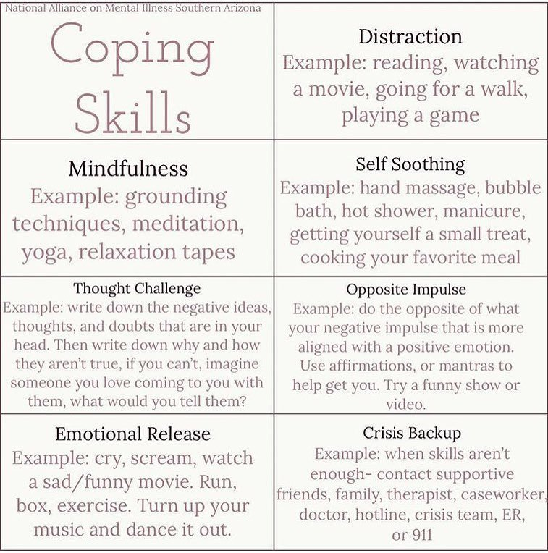

Slide 7
MIDITATION /MINDFULNESS
Meditation is an umbrella term for the many ways to a relaxed state of being. There are many types of meditation and relaxation techniques that have meditation components. All share the same goal of achieving inner peace.
Ways to meditate can include:

Slide 8
Guided meditation
Sometimes called guided imagery or visualization, with this method of meditation you form mental images of places or situations you find relaxing.
You try to use as many senses as possible, such as smells, sights, sounds and textures. You may be led through this process by a guide or teacher.

Slide 9
Mindfulness meditation
This type of meditation is based on being mindful, or having an increased awareness and acceptance of living in the present moment.
In mindfulness meditation, you broaden your conscious awareness. You focus on what you experience during meditation, such as the flow of your breath. You can observe your thoughts and emotions, but let them pass without judgment.

Slide 10
Qi gong
This practice generally combines meditation, relaxation, physical movement and breathing exercises to restore and maintain balance. Qi gong (CHEE-gung) is part of traditional Chinese medicine.
Tai chi
This is a form of gentle Chinese martial arts. In tai chi (TIE-CHEE), you perform a self-paced series of postures or movements in a slow, graceful manner while practicing deep breathing.

Slide 11
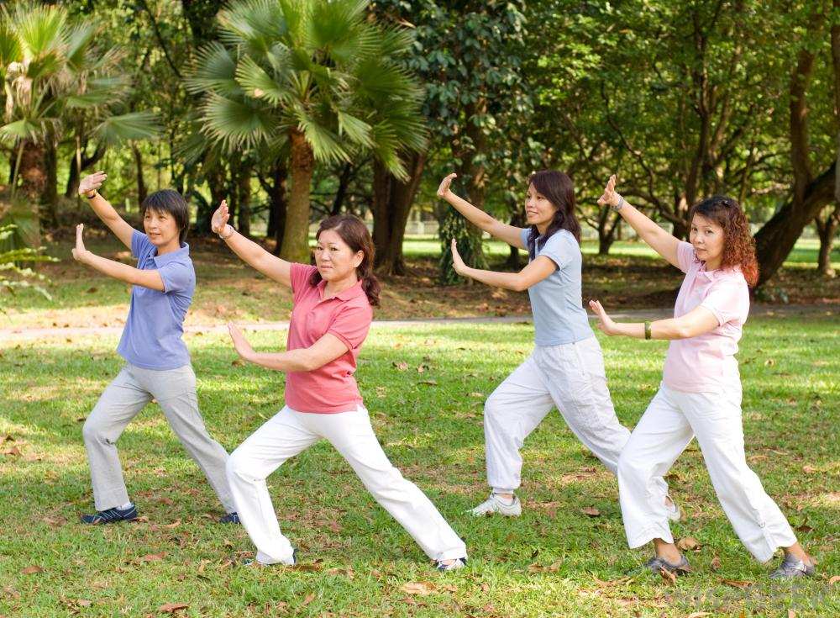

Slide 12
Transcendental Meditation
Transcendental Meditation is a simple, natural technique. In Transcendental Meditation, you silently repeat a personally assigned mantra, such as a word, sound or phrase, in a specific way.
This form of meditation may allow your body to settle into a state of profound rest and relaxation and your mind to achieve a state of inner peace, without needing to use concentration or effort.

Slide 13
Yoga
You perform a series of postures and controlled breathing exercises to promote a more flexible body and a calm mind. As you move through poses that require balance and concentration, you're encouraged to focus less on your busy day and more on the moment.

Slide 14
GUIDED IMAGERY
Guided imagery (also known as Guided Affective Imagery, or KIP, Katathym-imaginative Psychotherapy) is a mind-body intervention by which a trained practitioner or teacher helps a participant or patient to evoke and generate mental images that simulate or re-create the sensory perception of sights, sounds, tastes. Guided imagery techniques work to help people relax for several reasons. As is the case with many techniques, they involve an element of distraction which serves to redirect people's attention away from what is stressing them and towards an alternative focus. The techniques are in essence a non-verbal instruction or direct suggestion to the body and unconscious mind to act "as though" the peaceful, safe and beautiful (and thus relaxing) environment were real.

Slide 15
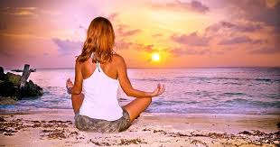

Slide 16
How to perform guided imagery
There is no single correct way to use visual imagery for stress relief. However, something similar to the following steps is often recommended:
Find a private calm space and make yourself comfortable.
Take a few slow and deep breaths to center your attention and calm yourself.
Close your eyes.
Imagine yourself in a beautiful location, where everything is as you would ideally have it. Some people visualize a beach, a mountain, a forest, or a being in a favorite room sitting on a favorite chair.
Imagine yourself becoming calm and relaxed. Alternatively, imagine yourself smiling, feeling happy and having a good time.

Slide 17
Focus on the different sensory attributes present in your scene so as to make it more vivid in your mind. For instance, if you are imagining the beach, spend some time vividly imagining the warmth of the sun on your skin, the smell of the ocean, seaweed and salt spray, and the sound of the waves, wind and seagulls. The more you can invoke your senses, the more vivid the entire image will become.
Remain within your scene, touring its various sensory aspects for five to ten minutes or until you feel relaxed.
While relaxed, assure yourself that you can return to this place whenever you want or need to relax.
Open your eyes again and then rejoin your world.

Slide 18
TYPES OF COGNITIVE IMAGERY
Positive imagery – perhaps the most classic form of guided imagery, this technique involves the use of a pleasant image or scene (tranquil nature scenes are often used) that enables you to feel relaxed, calm, and grounded. It can be utilized any time you need to switch from a state of anxiety to one of calm.
Negative or aversive imagery – this is the opposite of positive imagery. As the name suggests, aversive imagery involves the use of a highly unpleasant mental picture. For example, a woman striving to overcome bad eating habits causing unwanted weight gain may picture herself as obese and struggling to fit her body into a small airplane seat – in between two thin people. Aversive imagery is sometimes used in the treatment of alcoholism and other types of addiction.
Coping imagery – As the name suggests, this guided imagery method involves mentally rehearsing a new coping skill in order to better manage difficult people or situations. For example, mentally rehearsing your response to an annoying coworker can help you respond effectively to him or her, rather than react in a manner you will likely regret.
Anti-future shock imagery – This particular guided imagery technique can be especially helpful for anyone who is facing an anxiety-provoking event at some point in the future. For example, those who want to prepare themselves for the illness or death of a parent or spouse are instructed to imagine themselves coping effectively with the dreaded situation. This imagery technique helps to minimize the “awfulness” attached to the future event.
Associated imagery – Sometimes we experience troubling emotions but can’t quite pinpoint why they’re occurring. It involves thinking about the troubling feeling (e.g. guilt) and then make themselves feel it even more intensely. As they do this, they are to focus on the image (or images) that comes into their mind. Studying the image(s) and looking at it from different viewpoints allows them track the unpleasant emotion and can help them understand its origin or meaning.
Step-up technique – This imagery technique is designed to improve coping skills. It involves imagining an anxiety-provoking situation but exaggerating it – stepping up the intensity – so that the situation elicits fear is even greater, and then picturing yourself coping with it effectively. For example, if giving a presentation to a small group of co-workers causes a fair amount of anxiety, you could picture yourself giving it to an audience of 500 people – and picturing yourself coping with it very well.( guided-imagery-therapy)

Slide 19
DISTRACTION
There are many ways people may distract themselves away from stressful thoughts. Popular distractions include doing chores and work, engaging in hobbies and projects, socializing and seeking out sources of entertainment such as movies, games (including video games) and books. It helps if the activities are interesting, absorbing and immersive, as such things are easier for people to focus on for sustained periods of time. Things that are merely time occupiers may not hold attention, and therefore fail to distract people from their stress and worry for very long.Following are some effective distraction stratigies to manage stress and aanxiety

Slide 20
RELIGIOUS COPING
Religion can provide a framework for understanding emotional and physical suffering and can facilitate perseverance or acceptance in the face of stressors. Religious coping encompasses religiously framed cognitive, emotional, or behavioral responses to stress. It may serve many purposes, including achieving meaning in life, closeness to God, hope, peace, connection to others, self-development, and personal restraint (Pargament, 1997).
e.g Praying namaz and Quran e pak , or performing other religious activities which leads towards spiruality

Slide 21
HOBBIES OF INTERST
Reading novels , watching movies, going for walk ,dancing etc
Organization
A very good way to distract yourself productively is to do something to better organize your life. ..

Slide 22
EMOTIONAL RELEASE THERAPY
MER stands for Mental and Emotional ReleaseTherapy. Mental and Emotional Release® Therapy is a clinically researched approach to help you release stress, anxiety, fear and other negative emotions. You will be able to utilize MER to overcome procrastination, depression and phobias.
For example ; crying, screaming, turn up Your music and dance it out.

Slide 23
DEEP BREATHING
Deep breathing is one of the best ways to lower stress in the body. This is because when you breathe deeply, it sends a message to your brain to calm down and relax. .Breathing exercises are a good way to relax, reduce tension, and relieve stress .Breathing exercises are easy to learn.
Sit or lie flat in a comfortable position.
Put one hand on your belly just below your ribs and the other hand on your chest.
Take a deep breath in through your nose, and let your belly push your hand out. ...
Breathe out through pursed lips as if you were whistling. ...
Do this breathing 3 to 10 times.

Slide 24
AROMATHERAPY
Aromatherapy is a nice tool for stress relief because it has few (if any) known side effects, can be used passively (you can fill the room with scent while you attend to other activities, relieving stress in the process), and can be easily combined with other stress relievers (like massage or meditation, for example), for increased stress relief. Aromatherapy products are also widely available, making aromatherapy a convenient option.
EXAMPLE ; MASSAGE, BODY OILS, CANDLES, DIFFUSERS ETC

Slide 25
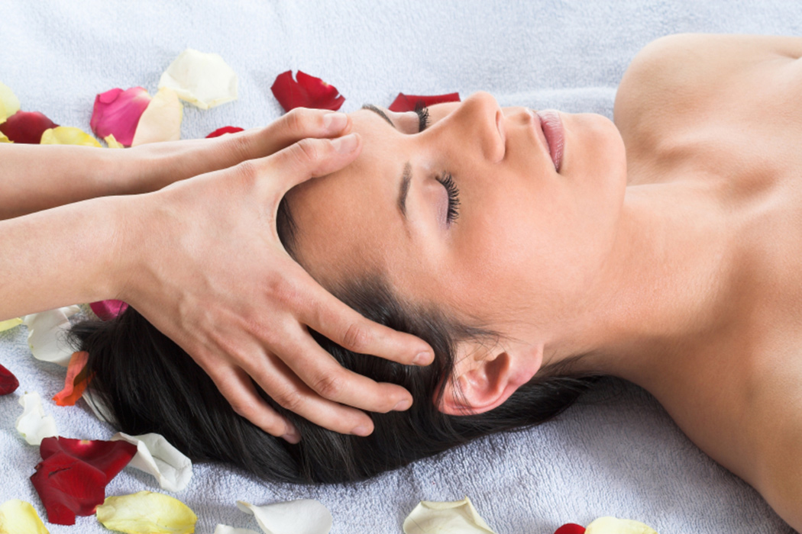

Slide 26
THANKS

